Slide 1





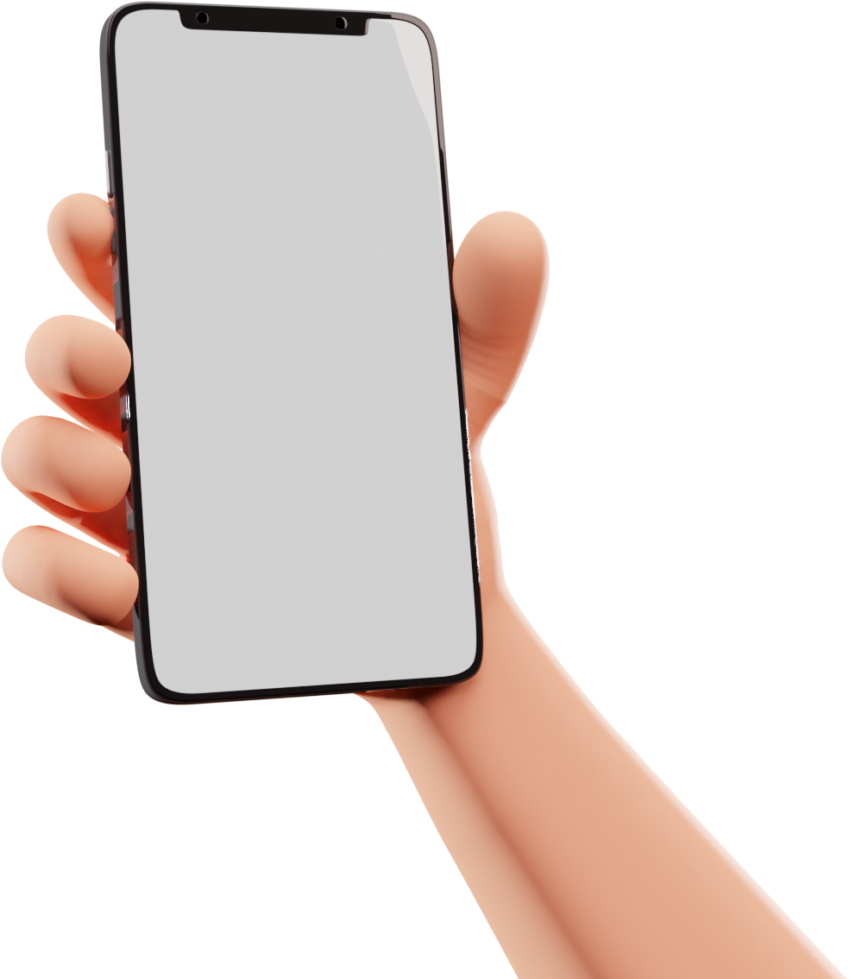


Group 8
MOBILE PROGRAMMING
PRESENTATION
Presented by Group 8
Course Code : CEF 440
Course Master: Dr. Eng Nkemeni Valery

Slide 2



Salford & Co.
FACTS
OVERVIEW
Mobile app programming refers to the process of creating software applications specifically designed to run on mobile devices such as smartphones and tablets.

Slide 3




Salford & Co.
REVIEW OF
MOBILE APPS
Mobile apps are categorized in various ways depending on how developers strive to achieve high quality while optimizing available resources and reducing costs.
Progressive
Native Apps
Hybrid Apps
Web Apps

Slide 4

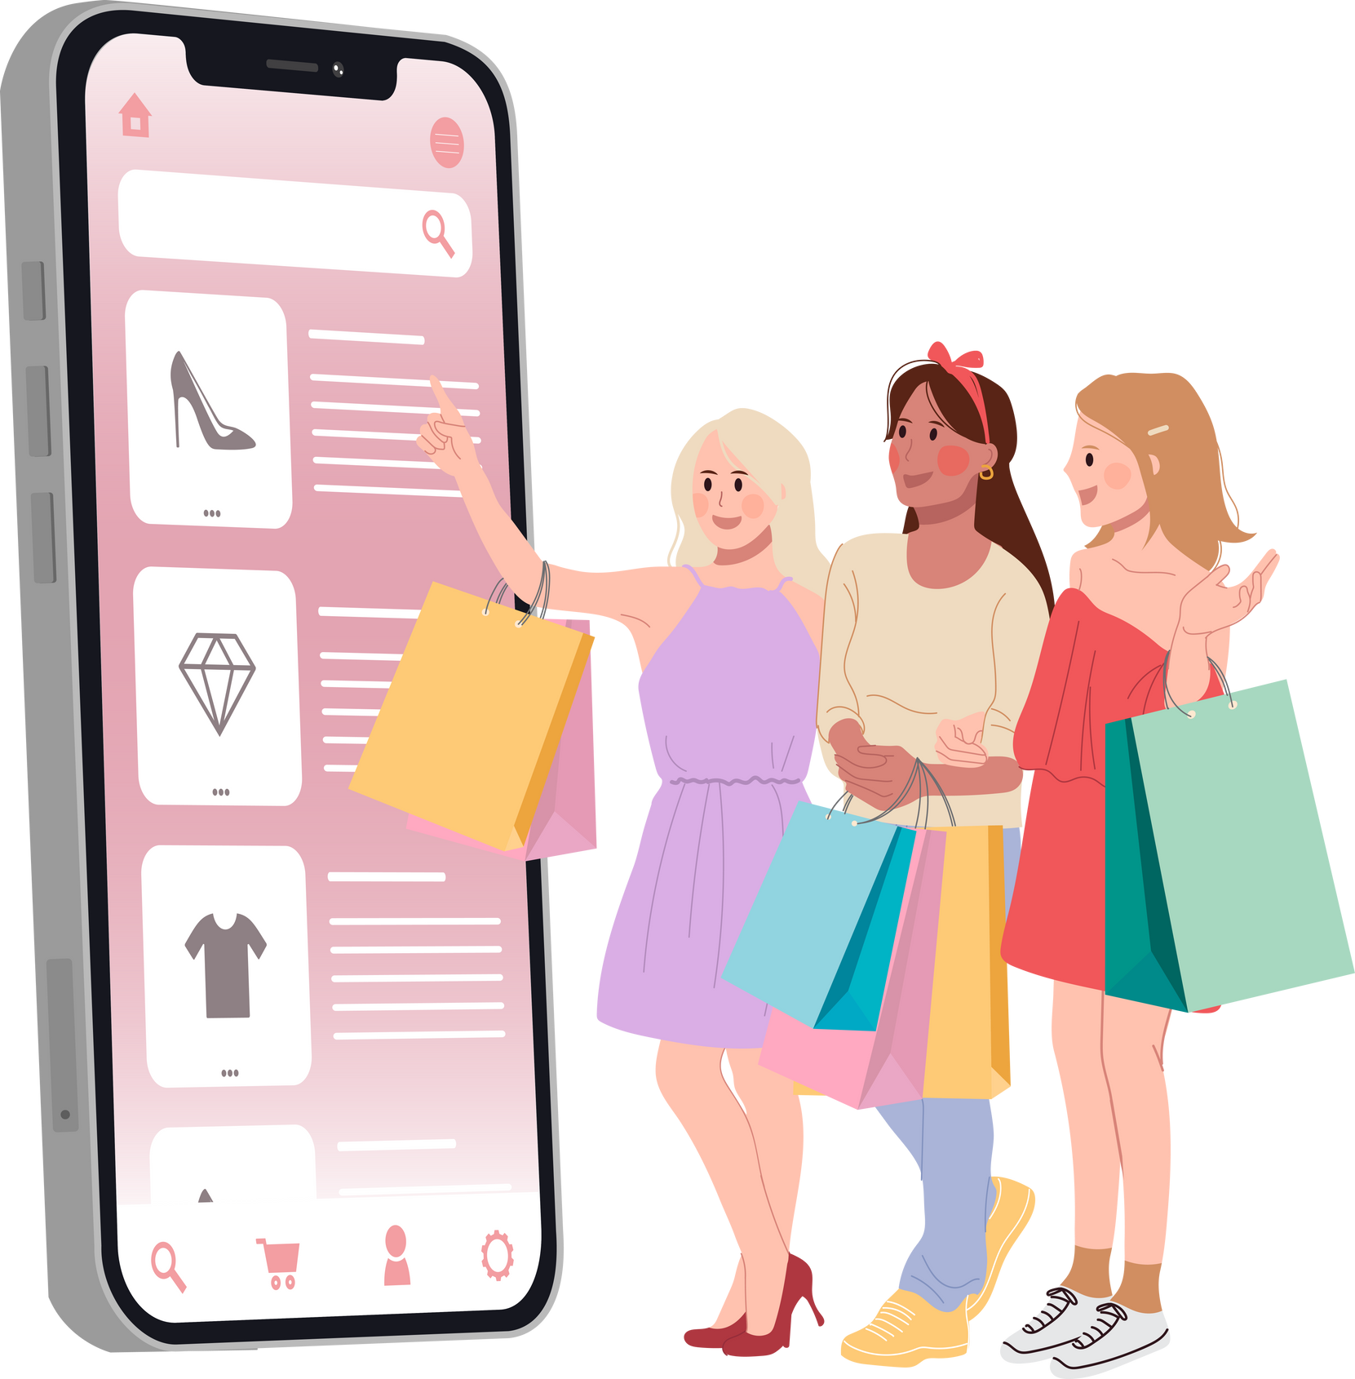
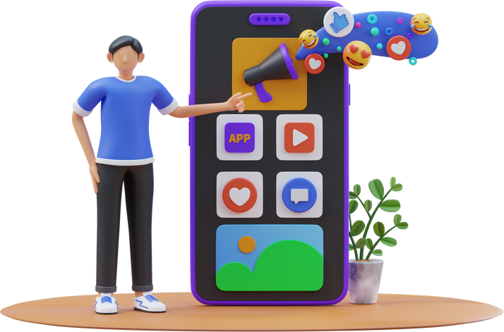


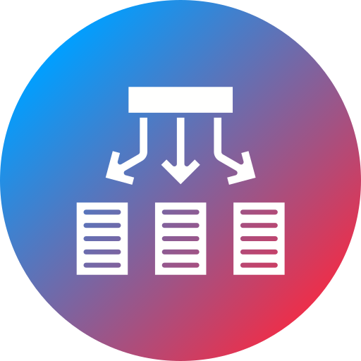
Salford & Co.
PROS
NATIVE
APPS
These are applications developed specifically for a particular platform. Hence written in the platforms Native Language.
Fast and
Reliable
Performant
They provide high performance apps and allow access to features like camera , GPS, speakers for an optimal user experience.
CONS
This app can be installed on the user’s home device.
Here are some Native Languages used to by popular industries Swift for IOS, Eclipse and Java for Andriod and C# and VScode of Windows
Examples of Native Apps are Facebook by Meta Inc.
Seperate
codeBases
Inconsistent
Versions

Slide 5

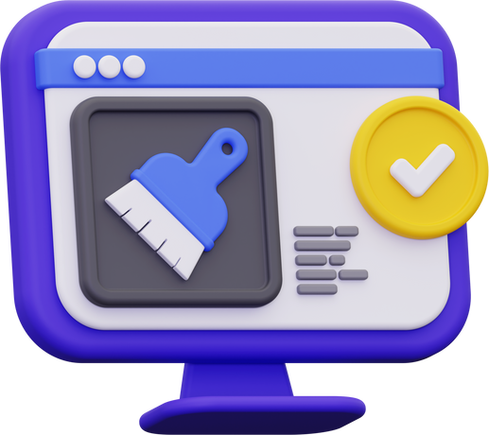


Salford & Co.
PROS
PROGRESSIVE WEB
APPS
These are applications that use web technologies to provide app-like-experience. They make us html, css and javascript as core languages.
They are access through the browser via specific URL
They can be added to our device home screen.
Examples of progressive apps are Twitter Lite, Pinterest.
Discoverability
Network independence
CONS
Broswer Dependent
Unreliable

Slide 6


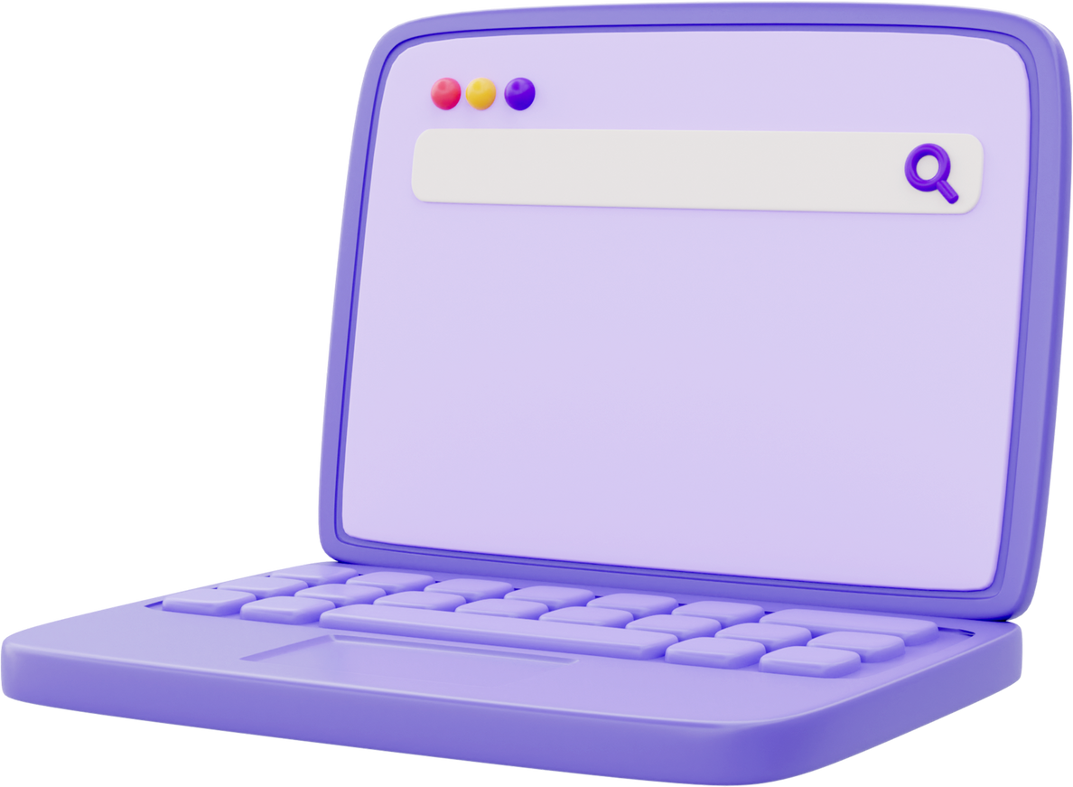
Salford & Co.
HYBRID
APPS
These are mobile applications buillt using mobile frameworks or web technologies and wrapped into a native container that enables them to be installed and run like native apps.
Technologies here can be Ionic, objective, HTML5
ECONOMICAL
LACK POWER AND SPEED

Slide 7
Salford & Co.
COMPARING DIFFERENT MOBILE APP TYPES
ASPECTS | NATIVE APPS | PROGRESSIVE APPS | HYBRID APPS
DEVELOPMENT LANGUAGE | platfrom specific languages (eg Swift, Objective-C for IOS, Java and kotlin for Android) | Web Based Technologies(HTML, CSS and JavaScript) | Web technologies (HTML,CSS,JS) with native wrappers such as React Native , ionic
DISTRIBUTION | App Store (eg Apple App , Google Play Store) | Accessed through web browser | App store (similar to native app)
PERFORMANCE | Best performance with direct hardware access | Generally moderate perfomance as it uses browser | Performance depends on framework complexity
EXAMPLES | Facebook (IOS and Android apps), Instagram(IOS and Andriod apps) | Gmail, Google Maps | Instagram , Twitter Lite use frameworks like React Native and ionic

Slide 8
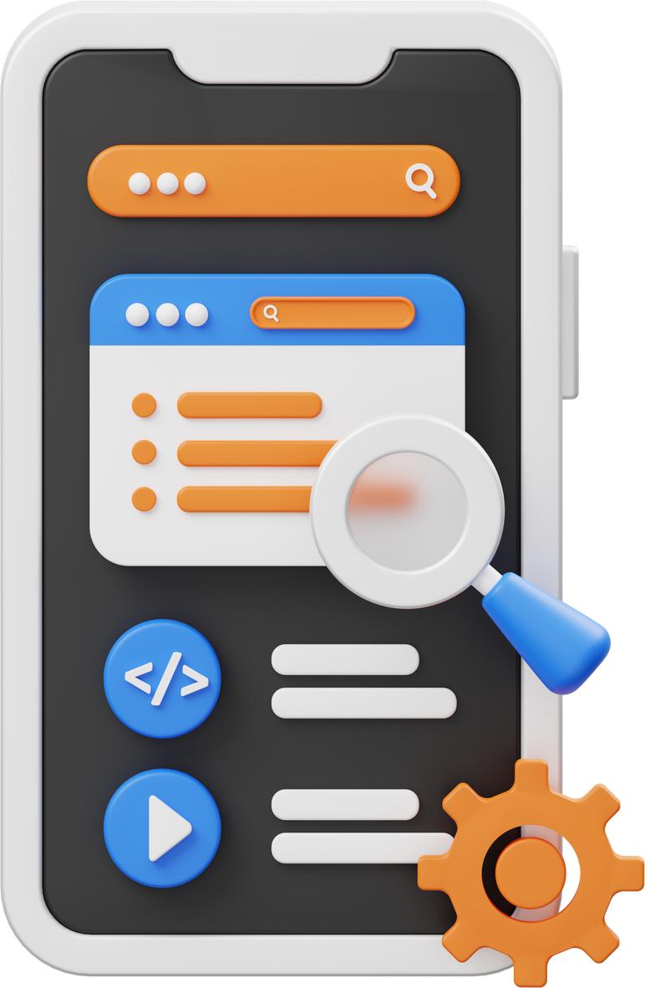
Salford & Co.
SIMILARITIES
All can deliver app-like appearance
All can deliver app-like appearance
Meet diverse Needs

Slide 9
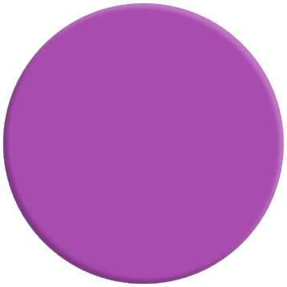




Salford & Co.
MOBILE APPS
PROGRAMMING LANGUAGE
Java
Swift
JavaScript
Swift is the primary language for IOS app development. it provides modern syntax and mostly used for VR AR
It is used for building hybrid apps and also cross platform apps using frameworks like react-native
Java is widely used for Android development as it provides scalable and Robust Applications
Kotlin
Dart
C#
Emerging as the preferred language for Android development aimed at improving Java
Used as Google’s native language for building mobile apps. it works together with flutter
Works for Microsoft Xamarin framework and is used to create cross platform mobile apps

Slide 10
MOBILE APP DEVELOPMENT FRAMEWORKS
Features | React Native | Flutter | Ionic | Kotlin
Language | JavaScript | Dart | Html, css, Javascript, | Kotlin
Performance | Very Good Condition | Excellent | Moderate | Excellent
Cost and Time | Cost effective and rapid | Cost effecive with slightly longer development | cost effective and quick | Moderate and requires expertise
Complexity | Moderate | Moderate | Moderate | High
use Case | simple to complex apps | simple to complex apps | simple to moderate apps | performant critical apps

Slide 11
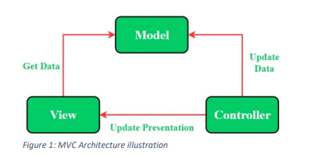
Mobile Apps Architecture
1.Model-View-Architecture
MVC is commonly used when designing simple applications as it’s more readily modified than others and makes implementing changes to the app simple. it typically divides the app into Model views and Controllers.

Slide 12
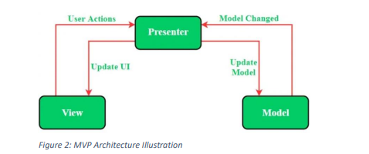
Mobile Apps Architecture
2.Model View Presenter
This is derived from the MVC pattern, and here, the “controller” is replaced by “presenter”. Performance-wise this pattern offers high reliability as there is less hindrance than with the other two models in terms of rendering frames.

Slide 13
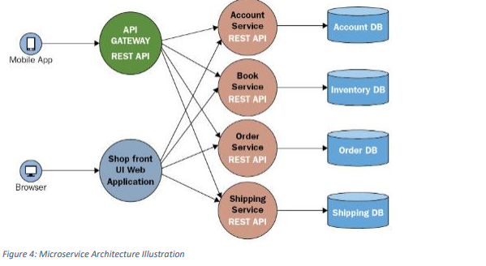
Mobile Apps Architecture
3.MicroService Architecture
Microservice architecture divides an application into smaller, loosely coupled services that communicate with each other over a network. While this is not unique to mobile application development, it is becoming increasingly relevant as mobile applications interact with backend services and APIs.

Slide 14
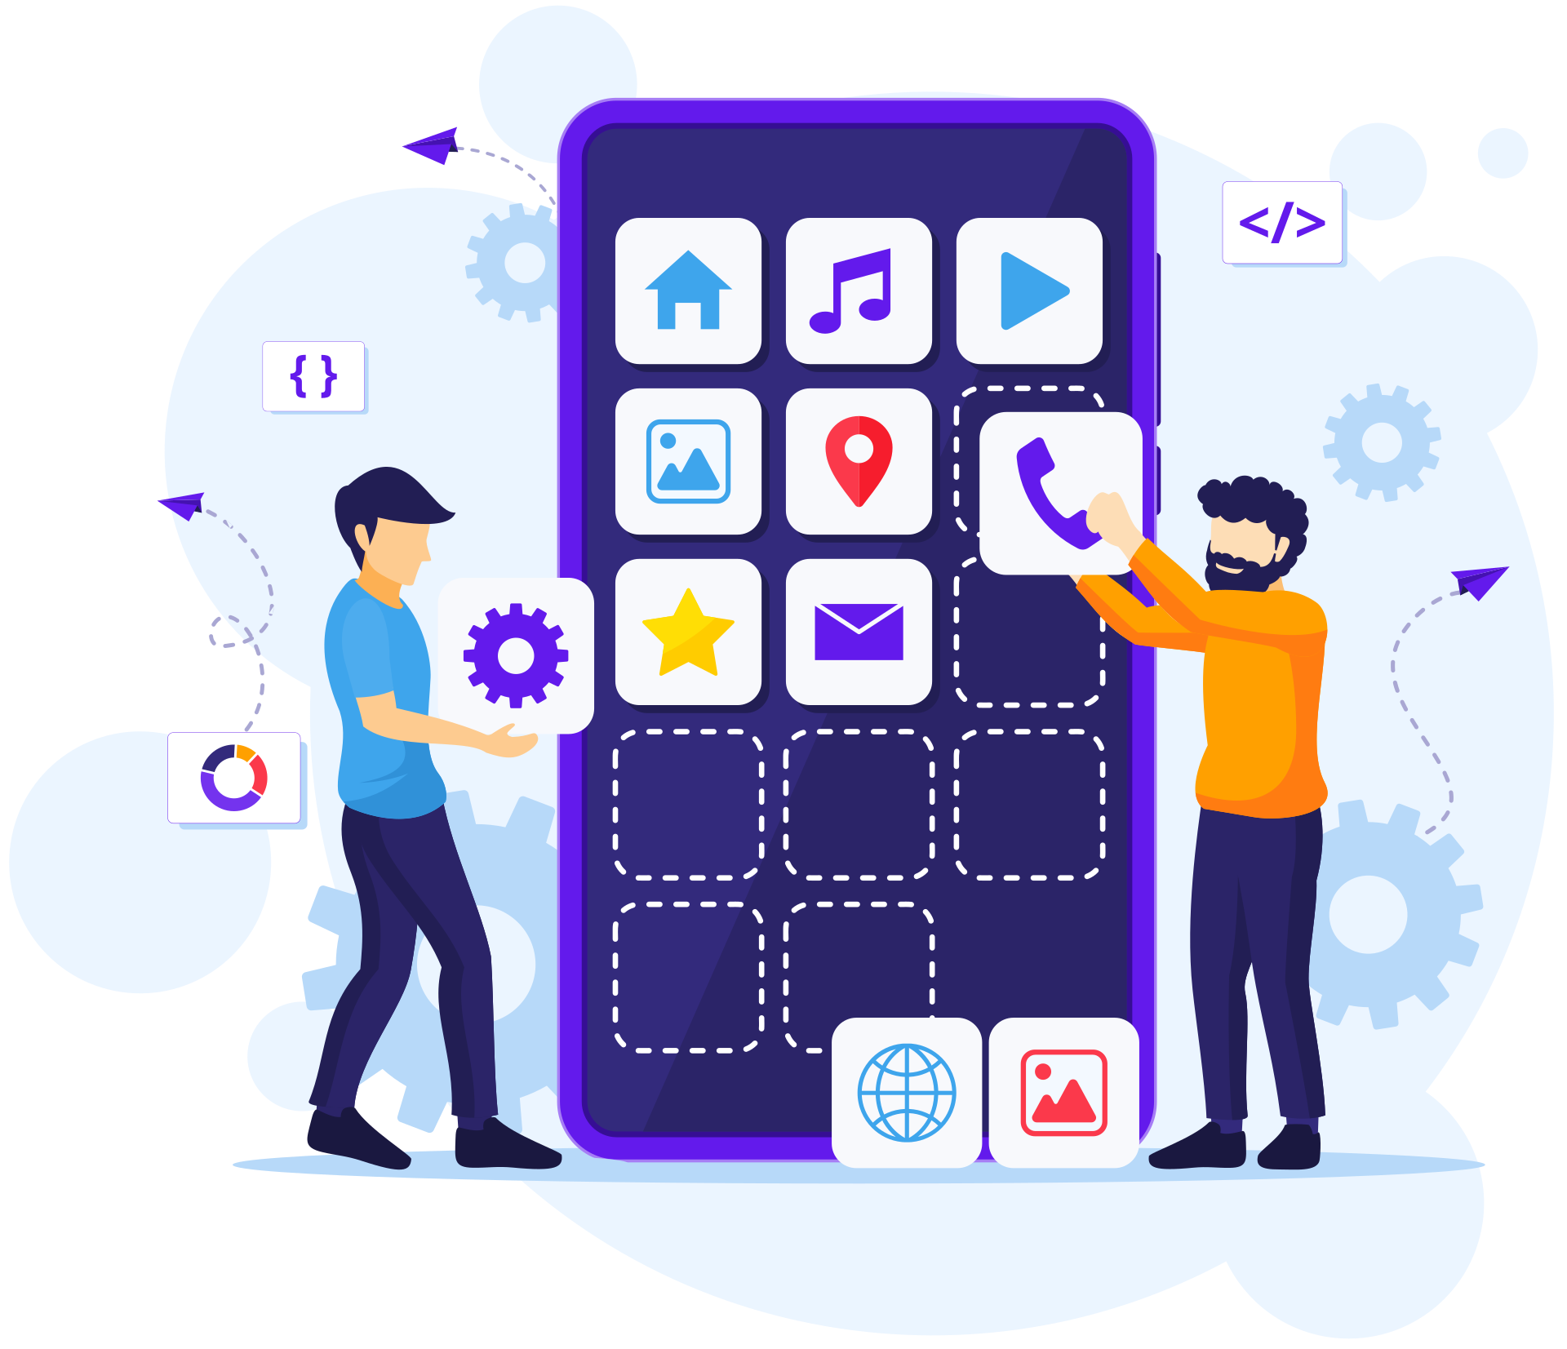
DESIGN
PATTERNS
Strategy Method Design Pattern
Composite Method Design Pattern
Observer Method Design Pattern
Adaptive
Design Pattern
Adaptive Design Pattern

Slide 15
REQUIREMENT ENGINEERING
PROCESS
Requirement Elicitation and Analysis
Software Requirement Specification
Requirements Verification and Validation
Requirements Management

Slide 16
ESTIMATE MOBILE APP
COST
The cost of developing a mobile app can widely vary depending on factors like Complexity, features, platform. Here are some following steps to follow:
Define Requirements
Breakdown Task
Estimate Time
Allocate Resources
Consider additional Cost
Calculate Cost
Documentation
Review and Adjust
In Cameroon due to labor cost the price of development may be lower ranging from $1000 - $10000 or more depending on the complexity

